Slide 1

— SC1015 Mini-Project —
The Titanic Disaster
B124_Team6: Jden Goh, Ananya Kapoor

Slide 2
— Contents —
1.
2.
Our Motivation
EDA
3
4.
Machine Learning
Conclusion
Dataset, problem definition
Data cleaning and visualisation
KNN, XGBoost, Random Forest Classifier
Comparing models, learning outcomes

Slide 3
1.
Our Motivation
Dataset, problem definition

Slide 4
Our Dataset
Titanic’s Passenger Data

Slide 5
— Our Motivation —
Getting a more insightful look into the disaster that occured
Analysing factors that may give insights to passenger’s survival rate

Slide 6
— Our Objective —
1.
2.
Identifying undiscovered loopholes in safety precautions or fail-safe measures
Further improvement of existing safety infrastructure in mitigation and response

Slide 7
Predicting who will survive the titanic disaster?
Based on passengers’ data

Slide 8
EDA
2.
Data cleaning and visualisation

Slide 9
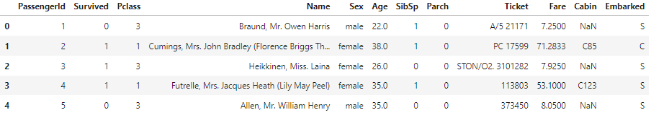
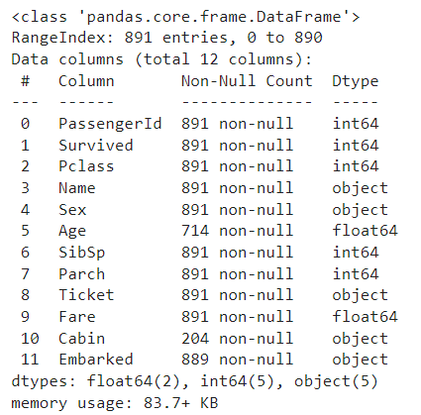
— Overview of our data —
Shape: (891, 12)
Some variables have NULL values, which we will deal with later

Slide 10
— Our Variables —
Pclass
Ticket class
SibSp
no. of siblings / spouses aboard the Titanic
Parch
no. of parents / children aboard the Titanic
Ticket
Ticket number
Fare
Passenger fare
Cabin
Cabin number
Embarked:
Port of Embarkation

Slide 11
— Data Cleaning —
1. Null Values and Outliers
Handling null values and extreme outliers
2. Data Adjustments
Making adjustments/combining variables
3. Encoding Categorical Variables
Performing encoding on categorical variables

Slide 12
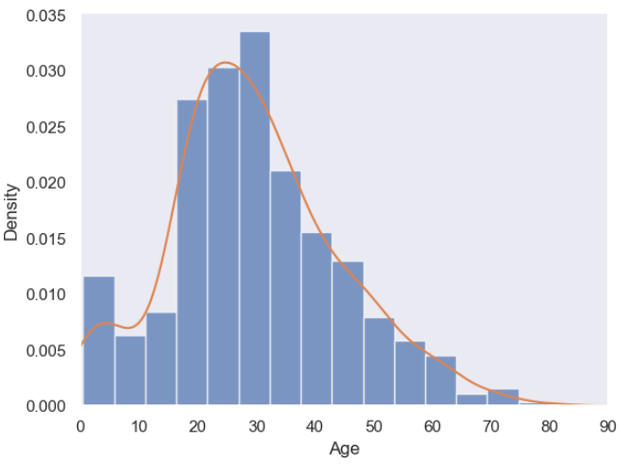
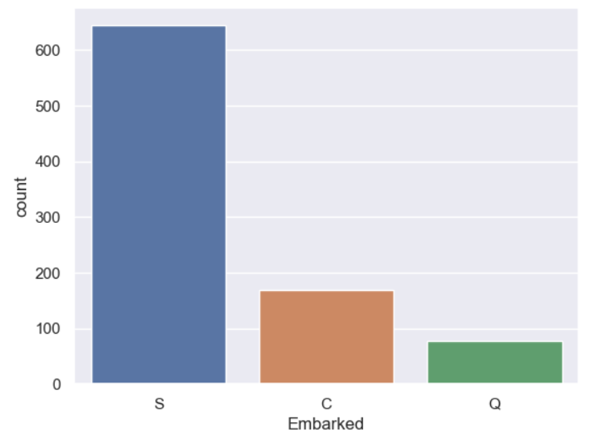
— Null Values and Outliers —
- Age -
- Cabin -
- Embarked -
Cabin is missing about 77% of its data
Due to insufficient information to fill in missing cabin values, it is safer to drop this column
- Fare -
Removed 3 rows with extreme outliers which can have huge impact on our prediction
Age is skewed to the right (positive skew)
Median will be suitable for filling the missing values
Only 0.22% missing
Mode will be suitable for filling the missing values, since this is a categorical variable

Slide 13
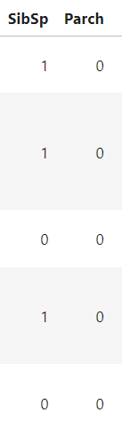
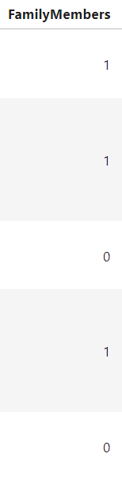
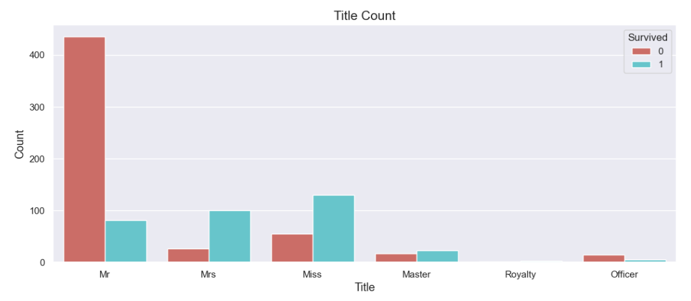
— Data Adjustments —
- Family Members -
- Title -

Slide 14
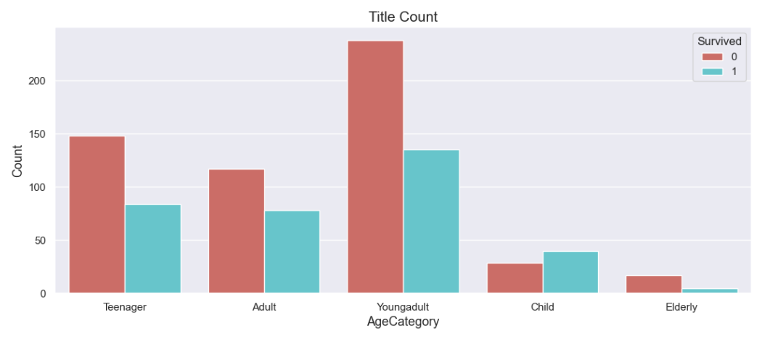
— Data Adjustments —
- AgeCategory -
Child: 0-12 years old
Teenager: 13-25 years old
Young Adult: 26-35 years old
Adult: 36-60 years old
Elderly: 61 years old and above

Slide 15
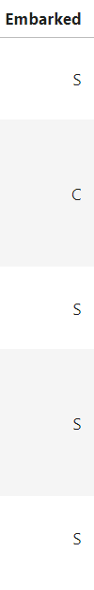
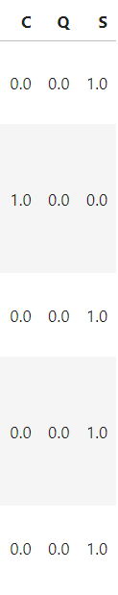


— Encoding Categorical Variables —
- Embarked -
Using one hot encoder
- Sex -
Using Label encoder

Slide 16
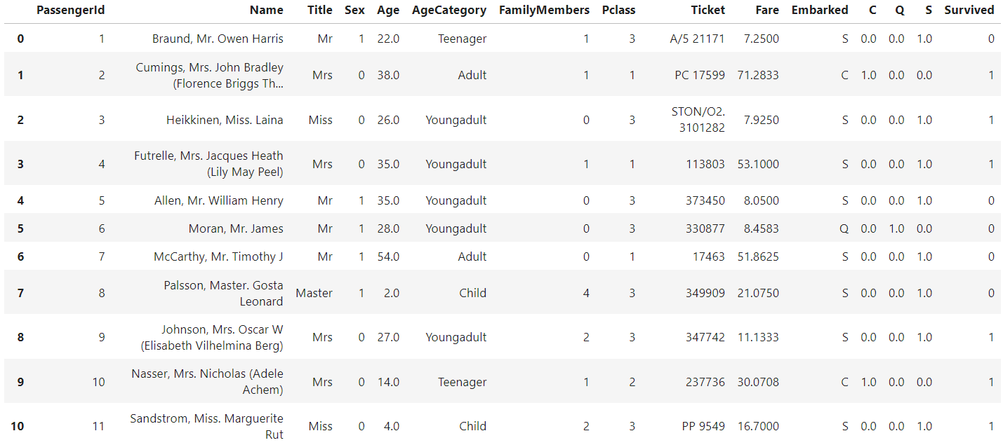
— Overview of Dataset so far —

Slide 17
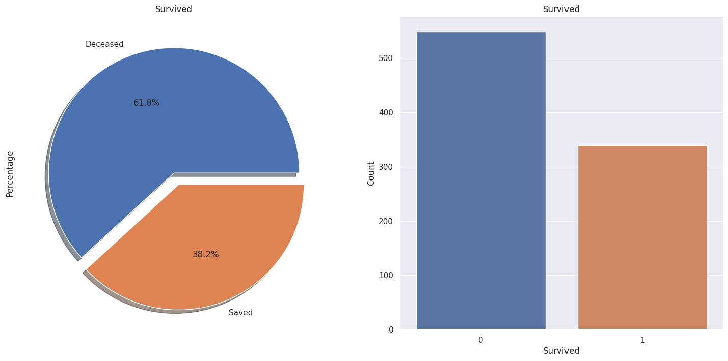
— EDA - Overview of Survivors —
Out of the 891 passengers on board, only around 38% of them survived.

Slide 18
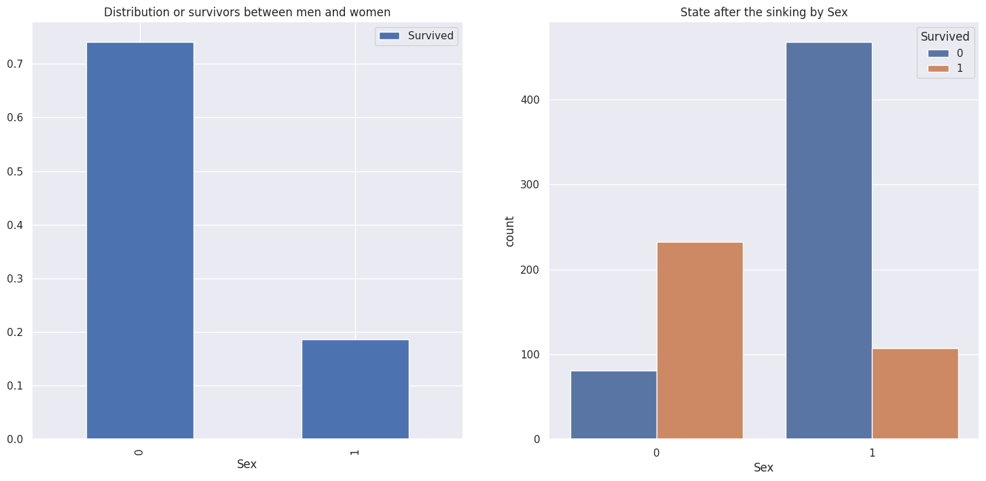
— EDA - Does gender affect survival? —
Most of the passengers on board are Male however females have a higher chance of survival. Less than 20% of the survivors are men.

Slide 19
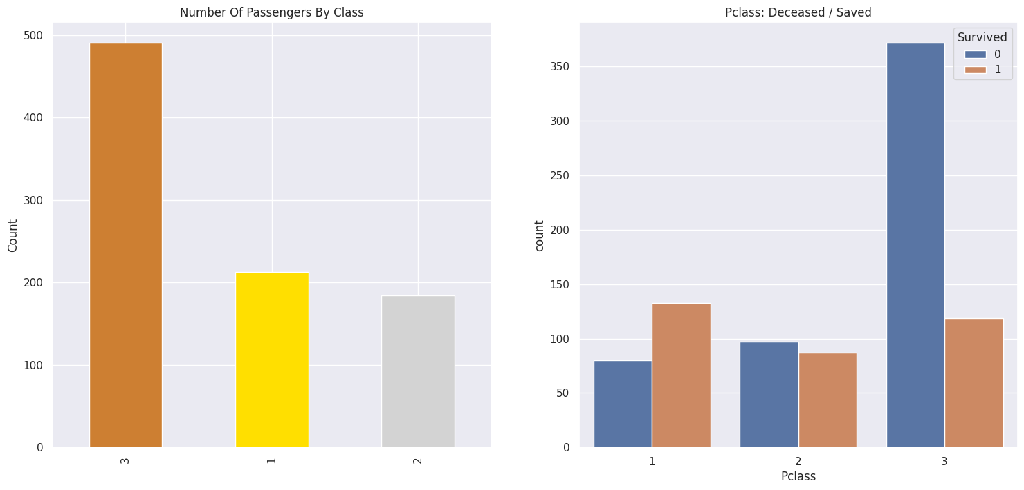
— EDA - Passenger Class —
Maximum passengers were in third class. However, as seen from the second plot, most third class passengers did not survive while majority of first class passengers did.

Slide 20
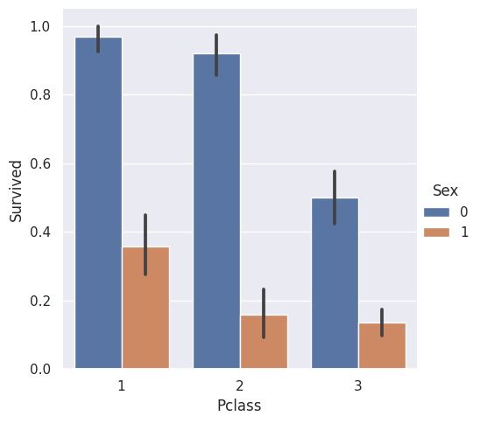
— EDA - Gender and Passenger Class —
As is evident, from all 3 classes, women were more likely to survive.
Only 3 women from first class did not survive as opposed to 77 men from first class who did not.

Slide 21
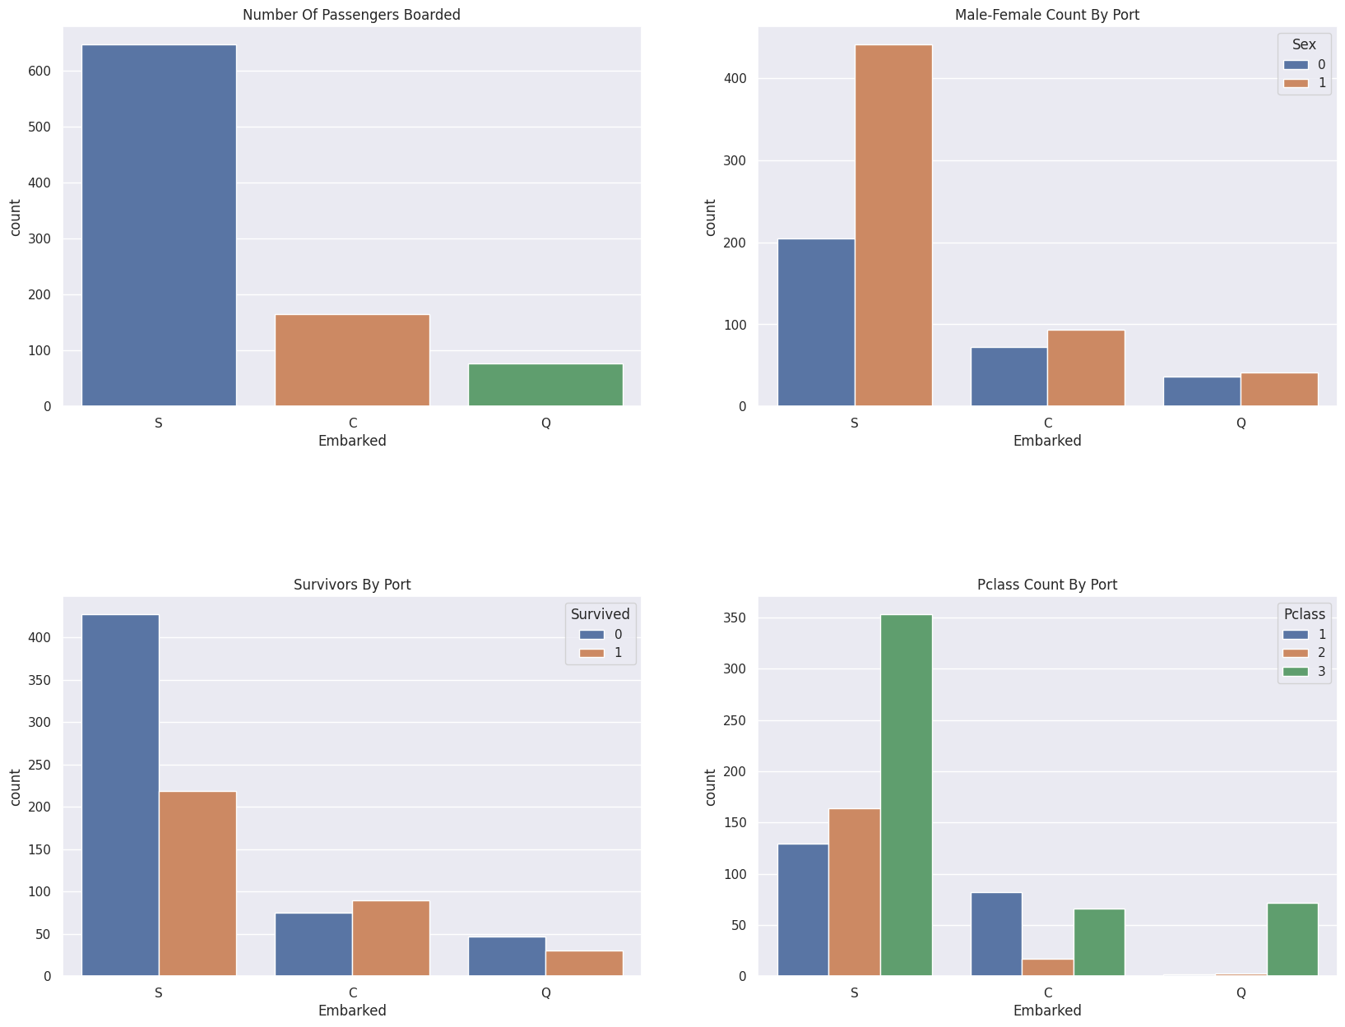
— EDA - Port of Embarkment —
Cherbourg has highest survival rate because of large number of first class passengers embarking.
Southampton has lowest survival rate because most passengers are in third class.

Slide 22
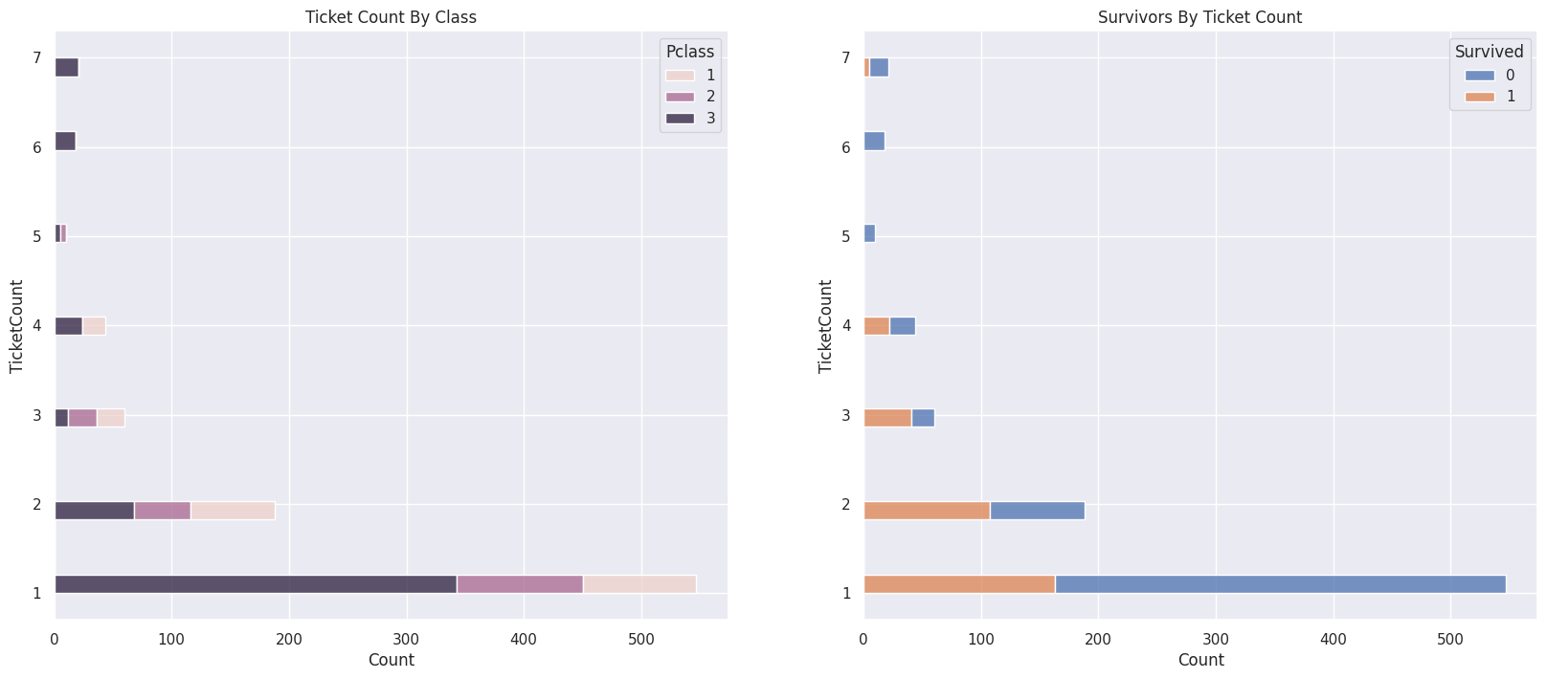
— EDA Importance of Ticket Number —
Duplicate ticket numbers indicate same family passengers.
Third class passengers had larger families and lower chance of survival.
Family size of 4 or more had next to 0 chance of survival.

Slide 23
Our Models
3.
Feature Selection
Models used

Slide 24
— Feature Selection - Chi-Squared Test —
Test for independence between the different categorical variables we have
Null Hypothesis: The 2 Variables are independent
Alternate Hypothesis: The 2 variables are dependent.
The function returns 2 array:
Chi-squared statistics
p_values

Slide 25
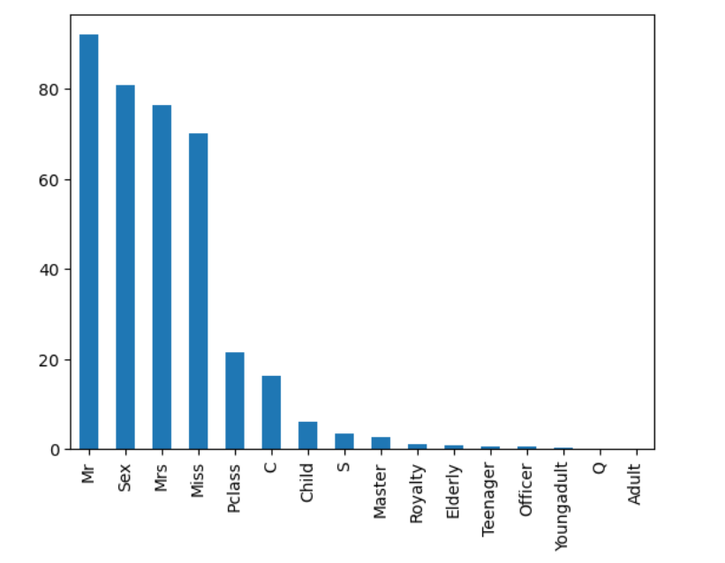
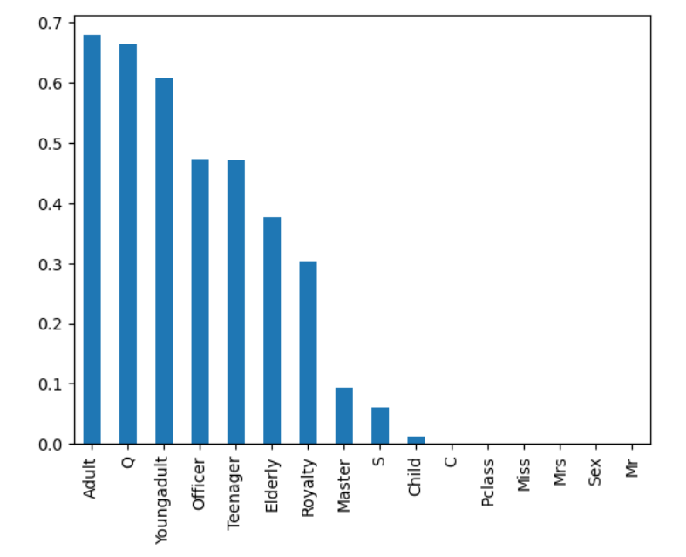
— Feature Selection - Chi-Squared Test —
- Chi-squared statistics -
- p_values -

Slide 26
— Explaining our Attempts —
- Attempt 1
Using all 18 features
- Attempt 2
Using best 15 features
- Attempt 3
Using all 10 features
- Attempt 4
Using all 8 features

Slide 27
— K Nearest Neighbour —
supervised machine learning model algorithm that can be used for classification.
classify a data point by looking at the classification of its nearest k-neighbours

Slide 28
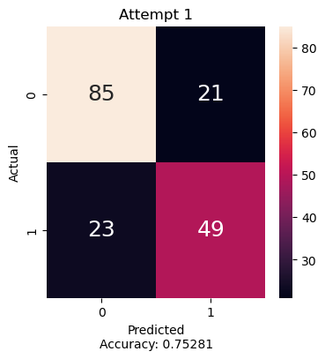
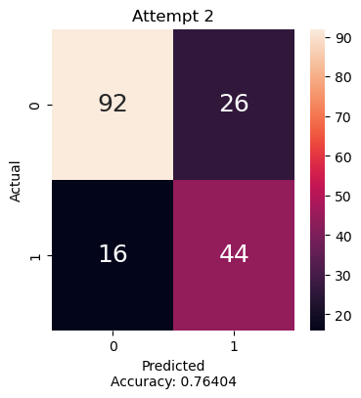
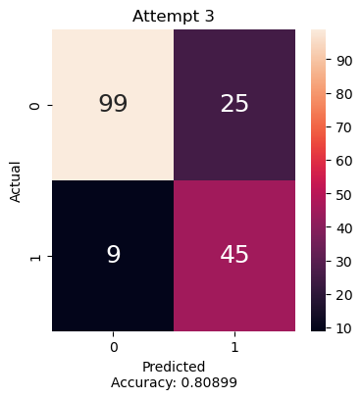
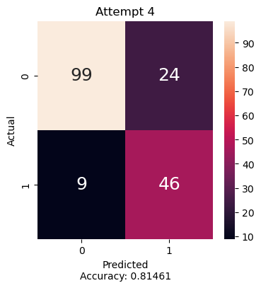
— Prediction Score - KNN —
Attempt 1.
Attempt 2.
Attempt 3.
Attempt 4.
Prediction
Accuracy Train: 0.817 Test: 0.753
Accuracy Train: 0.835 Test: 0.764
Accuracy Train: 0.839 Test: 0.809
Accuracy Train: 0.838 Test: 0.814

Slide 29
— Analysis —
Trend
As number of variables with least importance decreases, prediction accuracy on test set increases
Best Attempt
Attempt 4, using the most important 8 features identified during chi-square test

Slide 30
Curse of Dimensionality
Dimension VS size of Dataset

Slide 31
— XGBoost —
improvised implementation of a gradient boosting algorithm
It works by iteratively adding decision trees to a model, and with each new tree, it tries to correct errors of the previous tree
Our reasons for choosing this model were as follows:
It allows for parallel creation of trees
Trees pruning using depth-first approach
Regularization to avoid overfitting
Handle missing values using sparse approach
Inbuilt cross-validation

Slide 32
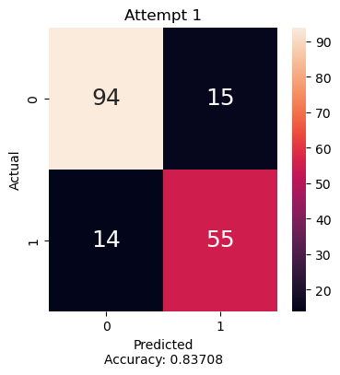


— Prediction Score - XGBoost —
Attempt 1.
Attempt 2.
Attempt 3.
Attempt 4.
Prediction
Accuracy Train: 0.938 Test: 0.837
Accuracy Train: 0.845 Test: 0.747
Accuracy Train: 0.838 Test: 0.814
Accuracy Train: 0.838 Test: 0.815

Slide 33
— Analysis —
Trend
XGBoost prediction accuracy on test set was generally highly accurate across all attempts
Best Attempt
Attempt 1, using all 18 features gave the highest prediction accuracy on test dataset

Slide 34
— Analysis —
XGBoost is a robust model with built in functions to improve on previous errors as it trains
In our case, since our dataset is relatively small, removing variables might end up worse off for robust models such as XGBoost
XGBoost has its own feature importance function, which roughly estimates the importance of each features provided as it trains
In our case, due to our limited dataset, perhaps it is better to allow the model to train with all the variable

Slide 35
— Random Forest Classifier —
Consists of a large number of individual decision trees that operate as an ensemble
Reduces overfitting by averaging multiple decision trees and is less sensitive to noise and outliers in the data
We chose random forest classifier because a large number of relatively uncorrelated models (trees) operating as a committee will outperform any of the individual constituent models

Slide 36
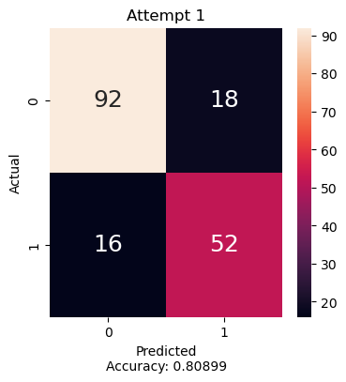
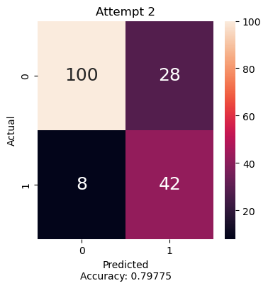
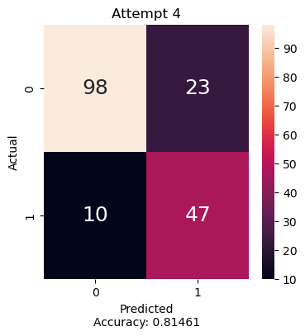
— Prediction Score - Random Forest —
Attempt 1.
Attempt 2.
Attempt 3.
Attempt 4.
Accuracy Train: 0.887 Test: 0.809
Accuracy Train: 0.844 Test: 0.798
Accuracy Train: 0.838 Test: 0.815
Accuracy Train: 0.835 Test: 0.815

Slide 37
— Analysis —
Trend
Test accuracy increased with lesser variables, training accuracy increased with more variables
Best Attempt
Attempt 3 and 4, using best 10 and 8 features, respectively

Slide 38
— Analysis —
Random Forest Classifier accuracy on the test data rises with reducing variables for prediction.
However, the training accuracy rises with increase in variables using for prediction.
This is likely because we encountered the issue of over-fitting.

Slide 39
Over-fitting
Model is closely fitted to details of training dataset
High accuracy on train data, low on test data

Slide 40
4.
Conclusion
Model Comparison
Learning Outcome

Slide 41
— OUR BEST MODELS—
XGBoost
Random Forest
KNN
Best model used all features
Robust model in itself
Best model was using 8 best feature
Curse of dimensionality
Best model: used 10 and 8 best features
Likely affected by Over-fitting

Slide 42
— Learning Outcomes —
Preparation
Data cleaning, removing null values, data adjustments
Feature selection
Chi-squared test
Encoding
One-hot encoding and label encoding
Models
KNN, XGBoost, Random Forest Classifier

Slide 43
Thanks!
Do you have any questions?
addyouremail@freepik.com
+91 620 421 838
yourcompany.com
Please keep this slide for attribution.

